Slide 1

BUKA Project Meeting Weeks
Tampere & Dublin
27.9.-7.10.2022

Slide 2
Pilot project updates
All partners presented on the progress of the local projects
All projects proceeding without major concerns
Many local events, partnerships and interventions have taken place

Slide 3
External evaluation: key points for development
Increasing cross-institutional collaboration and knowledge sharing
Monitoring plan for the pilot implementation
Evaluation framework for pilots

Slide 4

Monitoring plan
It was agreed that a monitoring tool will be used by all partners
Ria presented a prototype of the Excel-based tool and promised to refine it for the final version
Final version will have a summary page (all partners) and a separate tab for each partner
Both BUKA level and pilot level objectives
Challenges & recommendations for cross-institutional feedback
Hanna puts in the BUKA level objectives, all project managers update their pilot level objectives
The tool will be hosted at TAMK OneDrive, with editing rights to all partners. It will also be linked to Digma.
Check-up at every Management Team meeting.

Slide 5
Pilot evaluation framework
Impact
Quantitative, e.g. number of stakeholders reached/participated
Relevance
Qualitative, anecdotal
Experience
Students, teachers, project members, managers, community members etc.
Sustainability
Adaptability, scalability, cost-effectiveness etc.
Outcomes / products
Quality, usability, scalability

Slide 6

Handbook
Edited handbook
Target group: academics, teachers, developers, managers, students, decision makers involved in ODL
Published primarily as e-book, a small number of hard copies (less than 100)
TAMK eBook series (TAMK partners find out about the practicalities)
A handbook editorial board is put together, representative from each partner university
CC BY-NC-SA licenced
Style guide: APA 7

Slide 7

Handbook contents
Introduction to the themes of the handbook
  What, why
  Post-pandemic reflections; how the pandemic served as a driver for innovation and a source of reform
PART 1: Capacity building
  BUKA project level capacity building sessions / topics (from webinars) turned into brief chapters (universal design, authentic learning, learning design models, accessibility, etc)
  Dos and don’ts: what makes successful capacity building?
  Templates, materials, things that people can use
PART 2: Case studies / pilot projects
  Perspective: writing to colleagues, telling your story. “This is what we did and what we learned, and this is how you can do it too”

Slide 8
Handbook contents cont.
PART 2: Case studies / pilot projects
Description of each pilot project
  Introduction and rationale
  Methodology, process, objectives etc
  Challenges and how they were overcome
  Findings and lessons learned
  Sustainability and transferability (in the specific context of the pilot in question)
Conclusion
Foreword?? Let’s investigate our options
Open access equivalent to peer review?

Slide 9

Final conference
An open international conference in Penang: Technologies and pedagogies to enhance equity and accessibility of HE in ODL contexts.
October 2023 (Exact dates to be decided at the end of October 2022)
Call for abstracts: 1st call November, 2nd call February -> need to decide on sub-themes first
Conference info & submission instructions on BUKA website
Executive committee: representative from each partner university.
All partners participate in reviewing the abstracts -> the executive committee will determine the criteria
WOU to determine the number of attendees
Need to determine participation fee (not to make profit but cover for expenses and catering)
Keynote speakers from partners’ networks (no budget for fees)

Slide 10
Conference
We are targeting the people who are genuinely interested in the topic, not those who just want the publication points. We hope to connect people with similar interests, provide opportunities for networking and for creating a community of practice to advance equity and access of ODL in local contexts.

Slide 11
Blogs and news
Date | Who and what?
15.10.2022 | News item: Project weeks in Europe (TAMK) Blog post: Reflections on the project weeks in Europe (MSU-IIT)
15.11.2022 | Blog post: Handbook (DCU)
15.1.2023 | Blog post: WOU (topic to be confirmed)
15.2.2023 | Blog or news: Project week in the Philippines (UPOU)
15.3.2023 | Blog post: UNP (topic to be confirmed)
15.4.2023 | Blog or news: Project week in Malaysia (OUM)
15.6.2023 | Blog or news: Project week in Indonesia (UT)
Other news and blog posts are also encouraged! Whenever something related to BUKA happens locally (events, partnerships, programs – anything!), please write about it! The last part of the roster is updated in June 2023.
News: objective, informative
Blog posts: reflective, more personal

Slide 12
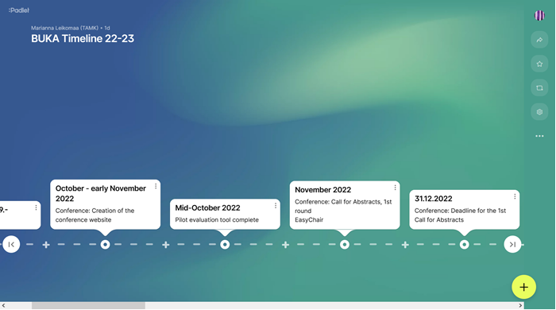
Timeline
The timeline continues to be updated and can be accessed online:
https://padlet.com/mariannaleikomaa/kdr91ywyalmqsbzj

