Slide 1
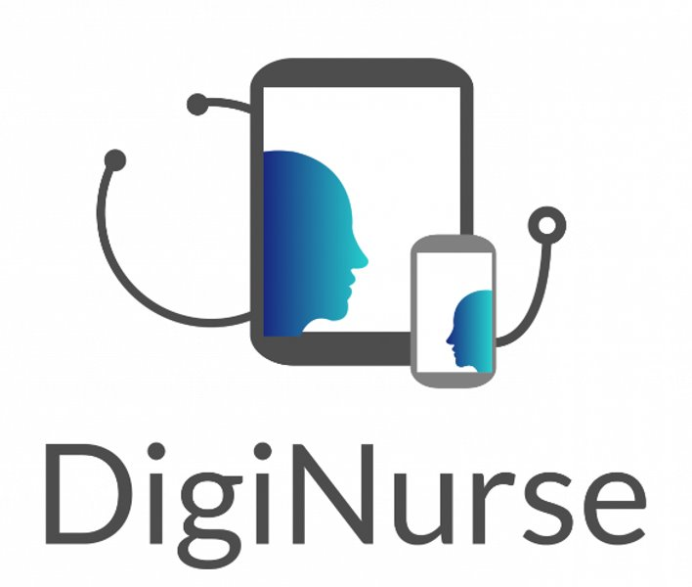

Project:
DigiNurse:
ICT Supported Self-Management of Patients 1.9.2017-31.8.2020
Erasmus+ Strategic Partnerships for Higher Education:
KA2 - Cooperation for Innovation and the Exchange of Good Practices
Raija Kokko
Project Manager, PhD (Health Sc.)

Slide 2






Slide 3
Title of Presentation:
Expreriences on Strategic Partnership project
Content:
- Choice of the project (topic, type, partners etc.)
The aim of the project
The progress of the project
Tips for project applicants of the year 2020

Slide 4

Choice of the project type and topic
Several options; why SP?
Choice of the Topic:
Idea:Erasmus teacher exchange in Northhumbria, Great Britain
TAMK & Karelia: idea generation by two teachers from Karelia University of Applied Sciences

Slide 5

Aims and Objectives:
To develop the DigiNurse Model for patients’ self-management of chronic conditions
To educate students, teachers, health care professionals, students’ mentors, clients/patients, representatives of the third sector for
The utilisation of the DigiNurse Model
To collaborate with national technological enterprises
To enhance the participants’ cooperation and network
To develop the guidelines of the application of the model for nursing education

Slide 6

Innovative Character
Digital chance has recently advanced fast and therefore curriculum, learning objectives, contents of courses, teaching and learning methods in nursing education need to be evaluated, updated and reconstructed.
The project process will emphasize learning of digital knowledge and skills in communication with all the participating partners and especially with the patients and representatives of the third sector.
The DigiNurse Model provides a lacking concept for developing the skills in nursing and coaching of patients' self-management with chronic conditions.

Slide 7

The expected results during and after the project are:
The DigiNurse Model is ready and it helps students to learn and apply their digital communication knowledge and skills while studying and taking care of their patients.
DigiNurse Community has grown beyond the partner consortium.
Evaluation of the digital skills of nurses and student nurses shows improvement.
The students gain better abilities to exploit digital skills in supporting and coaching self-management of the patients suffering from chronic conditions.

Slide 8
The expected results during and after the project are:
The teachers gain an effective model to organise the inclusion of building digital awareness and competence of their nursing students.
The working life receives new nurses with up-to-date skills in digital supporting aids and methods of nursing tasks with self-management of patients.
The patients get better support for the self-management of their chronic condition when the nurses can coach and support them better with available digital tools.
The digital health literacy among nursing students has increased.
The European ICT companies get valuable feedback on their products.

Slide 9
DigiNurse Methodology
Work packages
Activities in each work package
International Meetings, each partner works as a host at least once
Multiplyer Events
Monthly Status Meetings: (Skype), Zooms with the partners
Extra Zooms with two or three partners
Evaluation
Dissemination

Slide 10

About the Working Process
Set up of communication tools
Literature reviews: self-management, coaching, pedagogical approaches, technological tools, best practices in teaching and learning digital nursing
Survey a. 800-900 students
The first draft of the model
Piloting waves: students with each other, nationally, internationally, and during their clinical training with patients
Collecting qualitative and quantitative feedback from teachers/students
The final draft of the model (after corrections) by the end of May, 2020
Dissemination: (posters, conference presentations, website, piloting videos, animations, social media channels, Digi Market, e-book, etc.)

Slide 11
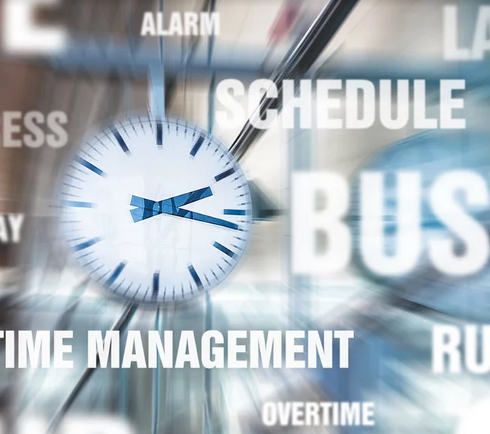
During the process
Profound discussion on crucial issues: e.g. scientific/not scientific publications, authors of publications etc.
Discussion on the participants’ perception of time every now and then (e.g. deadlines of assignments)
Project manager’s responsibilities/resources

Slide 12

Afterwards: Local Impact
DigiNurse model is tested and finalized.
Student nurses have successfully participated in the DigiNurse curriculum
Teaching and training staff are convinced of the added value of DigiNurse in the curriculum

Slide 13
Afterwards: International Impact :
DigiNurse community expands to other countries of Europe
Diginurse experience is shared among the international community
Better connections with European ICT companies

Slide 14
Afterwards: International Impact:
The teachers get an effective model for organizing the inclusion of building digital awareness and competence of their nursing students.
The working life receives new nurses with up-to-date skills in digital supporting aids and methods of nursing tasks with self-management of patients.
The patients get better support for their self-management of their condition when the nurses can coach and support them better with available digital tools.
The digital health literacy among nursing students has increased

Slide 15

Writing the application
”Clear-headedness” when writing the application; not too optimistic promises
The project teams of the participating organisations present many-sided expertise (e.g. an administrative expert, substance experts)
Discussion before, during and at the end of the process is important
Work packages, responsibilities/roles of each participating institution are clearly defined and discussed
Confirmation of administrative support, especially important for the coordinating institution
Project members’ commitment (especially important if the three-year project)

Slide 16
Consider ethical issues already when you are starting the project
Plan carefully measurement tools for evaluation
Use your international contacts; e.g. exchanges, earlier cooperatiion

Slide 17
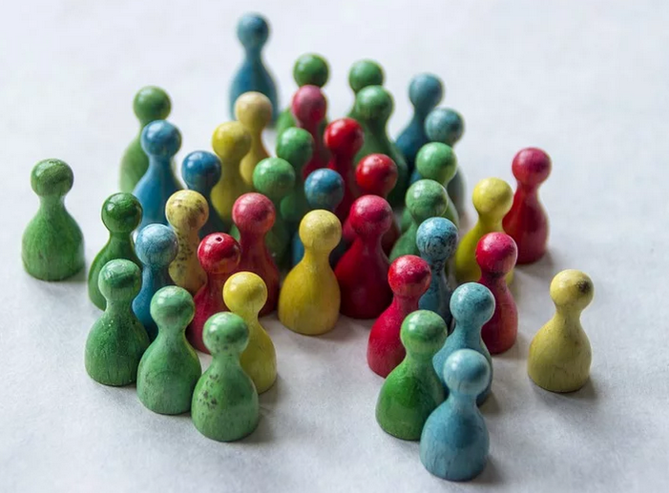
Recommendations for the application preparation:
Choose a ”hot”, future-oriented topic
Form a team with versatile competences: at least one person with earlier experience on writing the application (”applic. literacy”), English language (or other) skills needed
Reserve time for writing and reading the application: consult your Head of Education (usually takes more time than you have expected)

Slide 18
Links
https://projects.tuni.fi/diginurse/
https://www.facebook.com/groups/974533606222457/
https://projects.tuni.fi/digicareasia/

Slide 19

Enjoy the project process with all its challenges and sometimes ”bumpy road”! It’s worth it!
This Photo by Unknown Author is licensed under CC BY-SA

Slide 20


