Slide 1

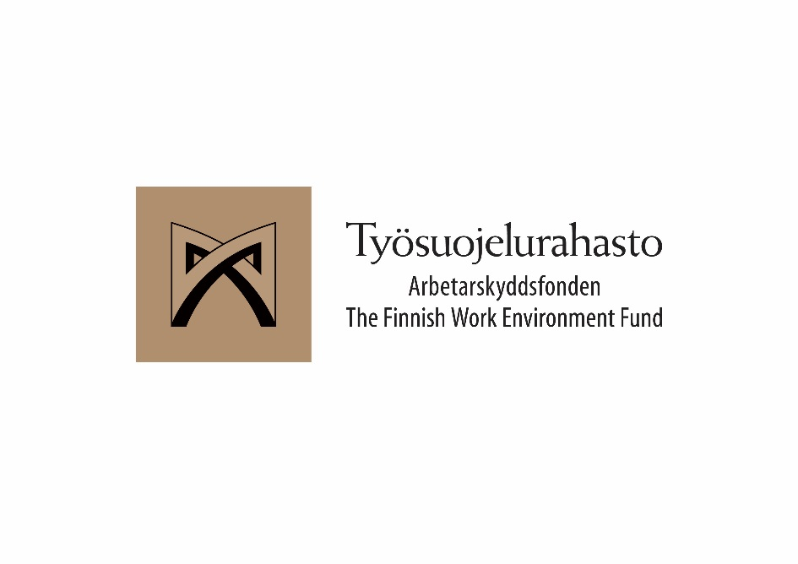

Industrial ethos and wider conceptions of skills
WORK 2019
Esa Jokinen Work Research Centre University of Tampere

Slide 2


Fragmented working careers?
Research project funded by the Work Environment Fund (TSR) 2018-2020
Coordinated by D.Soc.Sc. Satu Ojala
Global competition and technological development…
What happens to the working careers in backbone export industries – Forest, Metal, Chemical
Increasing / polarizing skills requirements..
Interviews of employees’ and employers’ sectoral organizations’ experts (N=13)
We also use FLEED – the linked employer-employee data of Statistics Finland – to follow the total populations of 15–70-year-olds from 1988 until 2016, analyzing the stability of employment and income and examining changes of workplace, occupation and industry, also through re-training.
We also ask whether firm’s investments in research and development (R & D) and ICT are associated with positive career development of personnel.
Our methodological approach is an application of sequence analysis suitable to estimate the stability of careers across cohorts and over time.
ANOTHER STORY

Slide 3
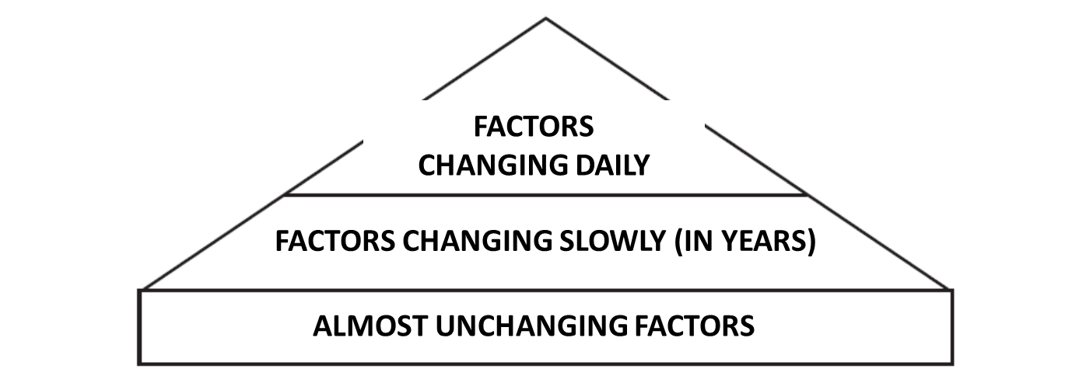
Industrial ethos (overlooked)
”Ethos” captures the collective sense of self-worth also in a very contradictory business like ”hard” industry and affects the mode of coordinated action
The development towards more sustainable industries and working life requires considering prior interpretive schemes on the sectoral level
Ethos is something that changes slowly, probably much slower than technologies

Slide 4
Wider conceptions of skills (also overlooked)
Upskilling? Deskilling? Reskilling?
The importance of recognizing the different levels and qualitative aspects of employee skills as part of the industries’ competitiveness and sustainable development
Skills are productive, expandable and social
The increase of skills does not always lead to increase of productivity
More crucial is the efficient utilization of skills = work organization and management, also restructuring of the sector
Technology not only transforms work but also creates new work - and skills

Slide 5
Research questions
What is the role of skills in the industries’ survival stories? What dictates them?
How are the skills and industries’ ”self-worth” intertwined?
To which extent are the social aspects of the skills recognized by the sectors / sector organizations?

Slide 6

Some results of thematic analysis of interviews
In the backbone industries, skills extensions are mostly driven by requirements of
administrative efficiency/tools
technological changes in production or ICT
customer / network orientation
systemic transitions.
Skills are laden with many meanings
Tremendous upskilling!
Technology is not much decreasing the amount of work, not even in the future
Enhancing and relying on higher skills in management and expert positions
Securing the availability of flexible labour and enhancing of career possibilities
Skills creation systems lagging behind the fluctuating reality

Slide 7
Tentative conclusions
The employer employee dichotomy has received more attention lately than the specificities of the industries (erosion of social dialogue)
The social and communicative skills are still under-valued in comparison with the work requirements
Sectoral skills strategies should better incorporate the systemic transitions, on-the-job learning attitudes (and attitudes overall), and the ”origin” of skills in the communities of practice

Slide 8
References
Darrah (1996). Learning and Work. An Exploration in Industrial Ethnography.
Dorobantu, S. (2018). Sustainability, Stakeholder Governance, and Corporate Social Responsibility.
Green, F. (2011). What is Skill? An Inter-Disciplinary Synthesis.
Green, F. (2013). Skills and skilled work.

Slide 9
Kiitos!

